Slide 1
MongoDB Relational Queries
JITHIN JOSE

Slide 2
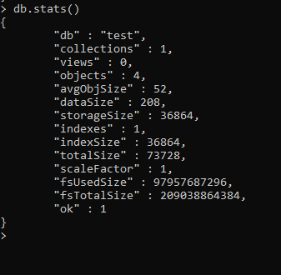
Fetch the Statistics of db

Slide 3
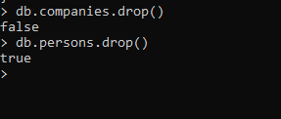
Dropping the collection

Slide 4
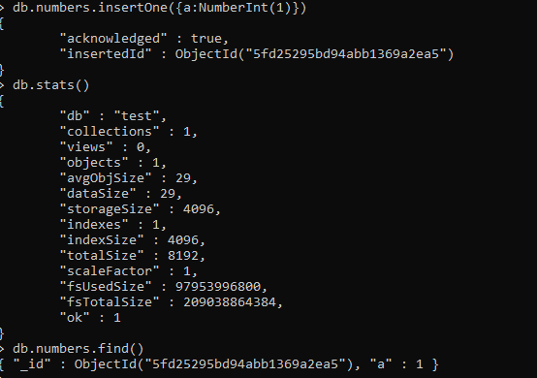
Inserting the data and checking in db statistics

Slide 5
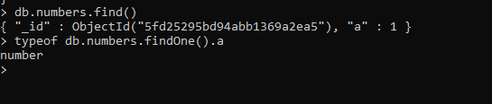
Finding the datatype of a variable

Slide 6
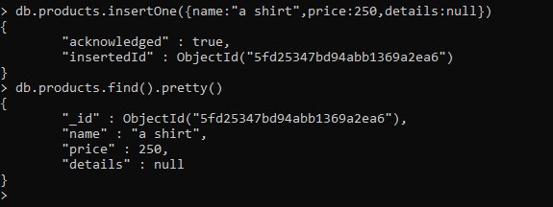
Assigning null value to document field

Slide 7
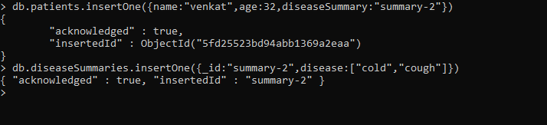
Patient-disease relationship

Slide 8
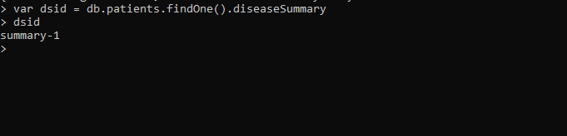
Using a variable to store data

Slide 9
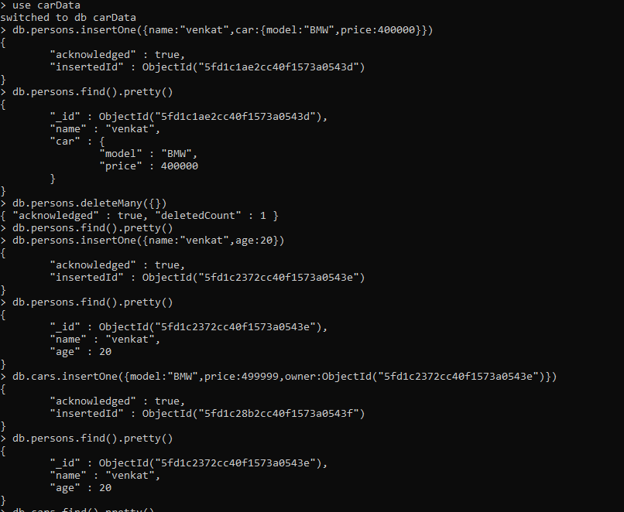
One-to-one (person-car) relationship

Slide 10
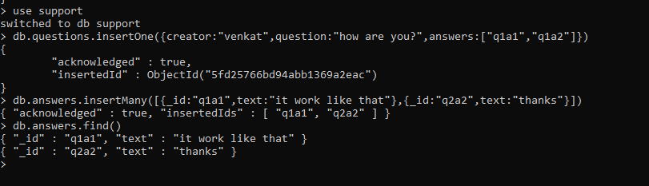
One-to-many(Thread-Answers) relationship

Slide 11
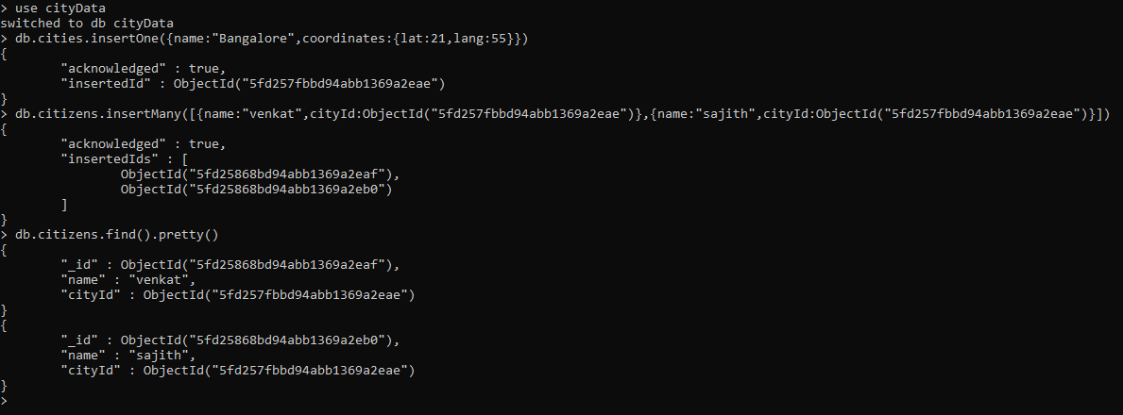
One-to-many with references

Slide 12
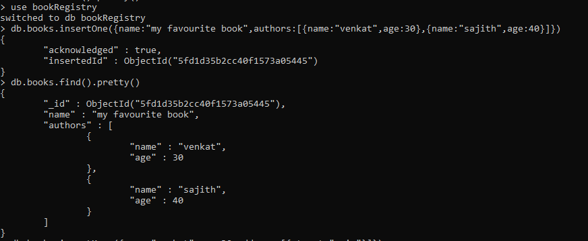
Many-to-many (books-authors) relationship

Slide 13
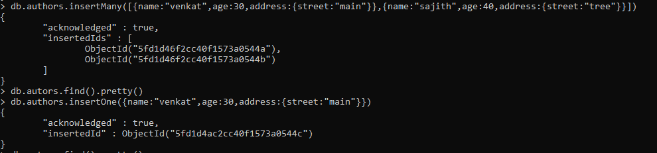

Slide 14
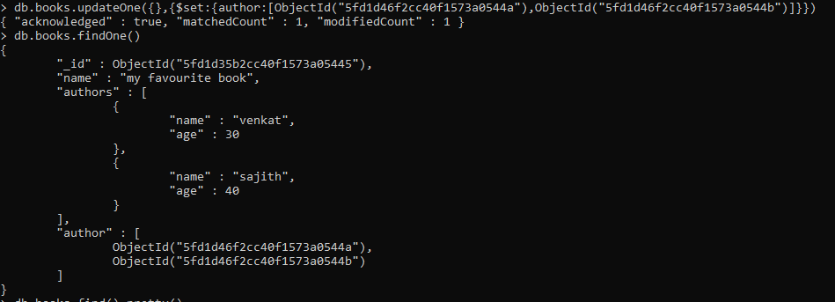

Slide 15
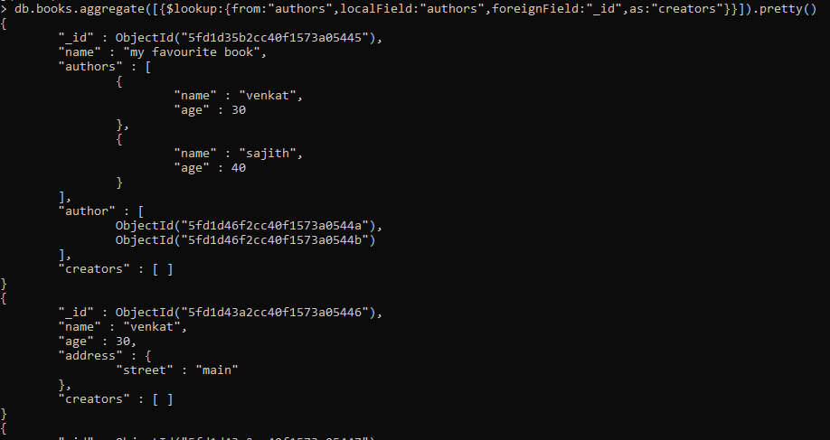
Joining two tables with lookup

Slide 16
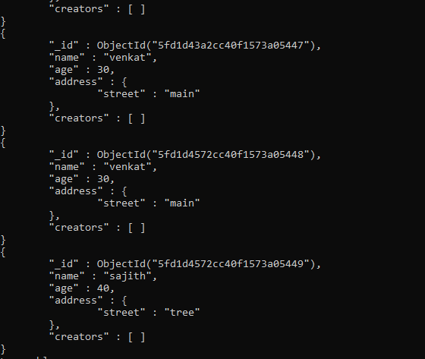

Slide 17
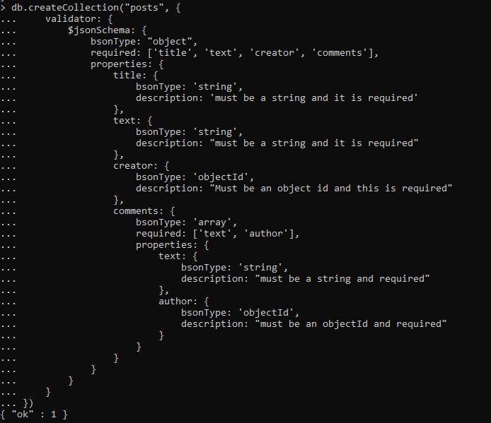
createCollection schema

Slide 18
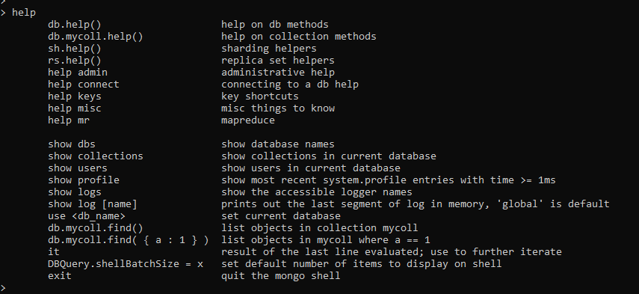
help

Slide 19
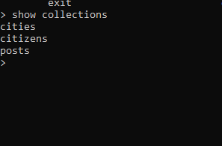
Showing all the db collections

Slide 20
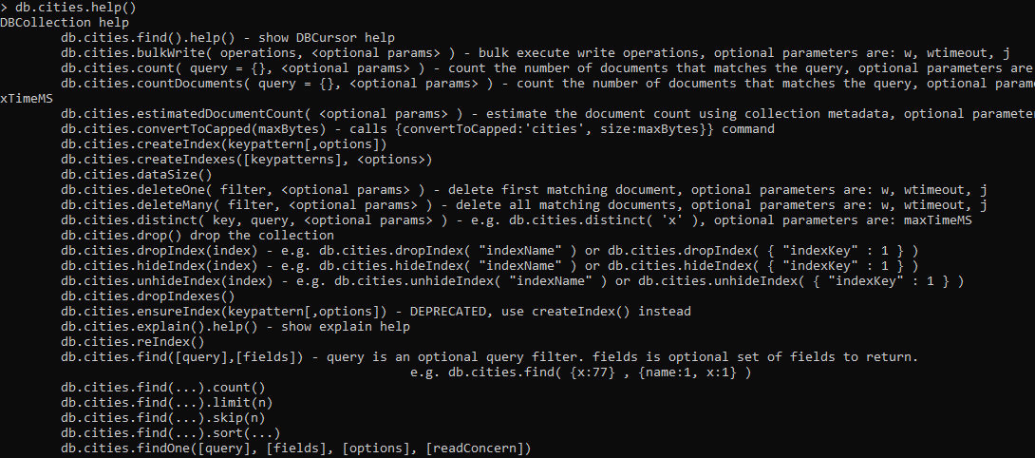
DB Collection help

Slide 21
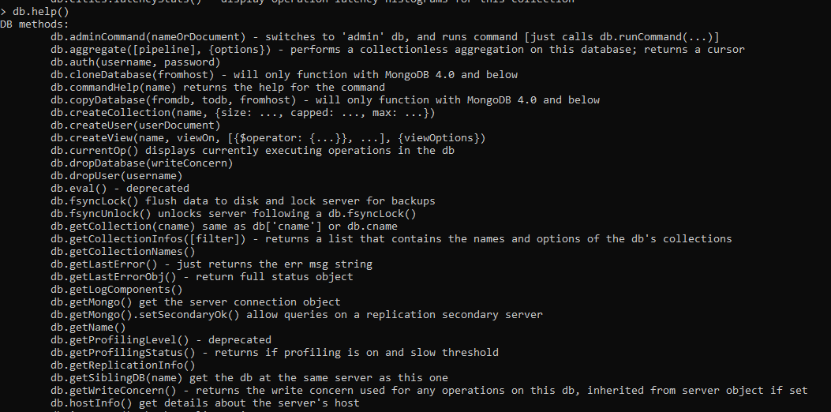
DB methods

Slide 22
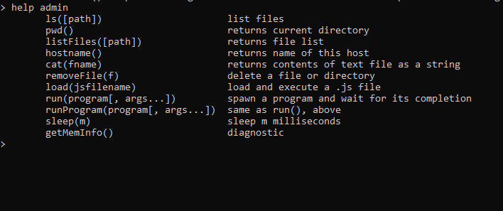
Admin help

